Slide 1

Learn. Imagine. Build. .NET Conf
What’s new in Xamarin
James Montemagno

Slide 2





Who’s this guy?
Weekly development podcast
mergeconflict.fm
Weekly development show
xamarinshow.com
James
Montemagno
Principal Program Manager – Mobile Developer Tools, Microsoft
motz@microsoft.com Montemagno.com @JamesMontemagno

Slide 3
What is Native?

Slide 4
Native User Interfaces
Native API Access
Native Performance

Slide 5

Xamarin’s unique approach
iOS C# UI
Android C# UI
Windows C# UI
Shared C# logic
Shared C# codebase • 100% native API access • High performance

Slide 6



Xamarin Native – Traditional UI
iOS C#
Android C#
Windows C#
Shared C# Logic
3 Native User Interfaces
Shared App Logic

Slide 7

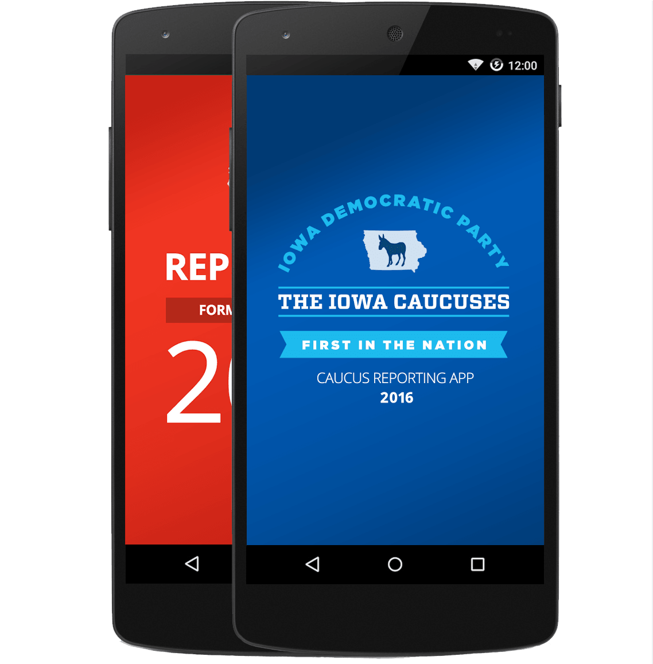
Xamarin.Forms- Cross Platform UI
Shared UI Code
Shared C# Logic
Shared Native User Interface
Shared App Logic

Slide 8
Code sharing stats
iCircuit
Touch Draw
Evolve App
(Xamarin.Forms)
Android
iOS
Mac
Windows

Slide 9
Xamarin Platform is
included in Visual Studio
Including Community Edition
Notes:
Including the Free Community Edition

Slide 10

Open Source – open.xamarin.com

Slide 11
Demo:
Xamarin End-to-End

Slide 12
Simplifying Development & Sharing More Code

Slide 13

.NET
Everywhere
Device native
.NET
Cloud native
.NET Everywhere
.NET STANDARD LIBRARY

Slide 14
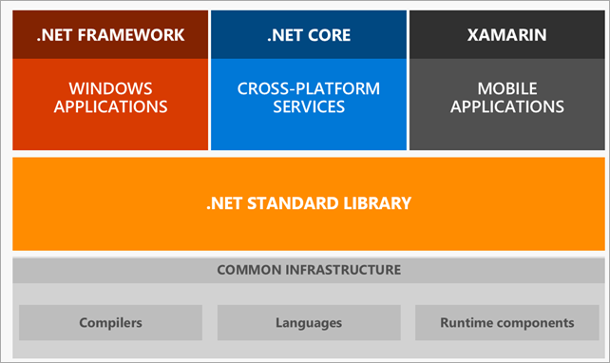
.NET Standard

Slide 15
Shared C# Backend

Slide 16
Plugins for Xamarin & Windows
Xamarin.com/plugins
Common API

Slide 17
Demo:
Plugins for Xamarin

Slide 18
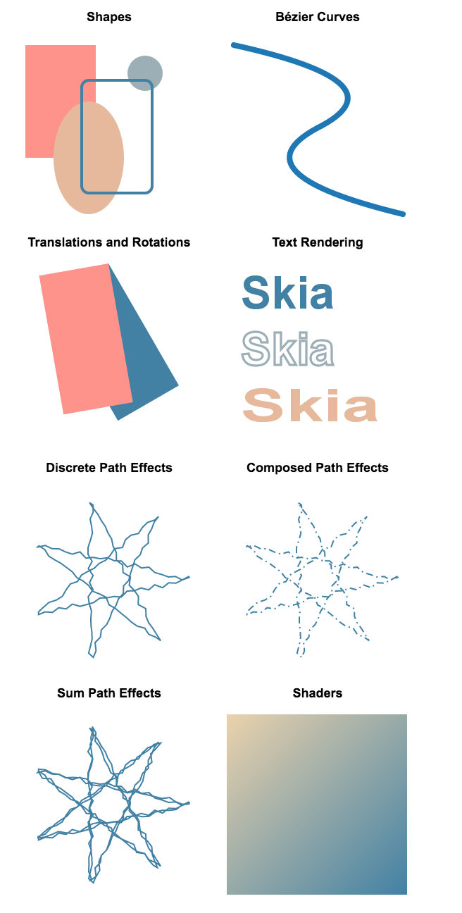

2D Graphics Library
SkiaSharp
The 2D graphics engine
Powers Google Chrome and Android.
Cross platform: Android, iOS, Mac, UWP, tvOS, Windows
Comprehensive
Image loading and saving
Immediate composited rendering mode
GPU accelerated (where available/enabled)
Custom effects and shaders
SVG Loading
http://aka.ms/skiasharp
Shapes
Bézier Curves
Translations & Rotations
Text rendering
Discrete Path Effects
Composed Path Effects
Sum Path Effects
Shaders

Slide 19


Xamarin & Xamarin.Forms ecosystem

Slide 20
Demo:
SkiaSharp + MicroCharts
https://github.com/aloisdeniel/Microcharts

Slide 21
Xamarin + Xamarin.Forms
iOS C# UI
Android C# UI
Windows C# UI
Xamarin.Forms
Shared C# Logic
Shared C# Logic
Traditional Xamarin approach
With Xamarin.Forms: More code-sharing, all native

Slide 22

New Platforms
Samsung Tizen
Televisions, Wearables, Mobile
macOS
WPF
Linux: GTK#

Slide 23
Embedding
Works on ContentPages
Full support for DependencyService and MessagingCenter
Xamarin.Forms
iOS C#
Android C#
Windows C#
Shared C# Logic

Slide 24
Demo:
Xamarin.Forms for macOS
Xamarin.Forms Embedding

Slide 25
Get started today
visualstudio.com

Slide 26

Free self-guided courses
Take free self-guided courses that cover the core Xamarin concepts and count towards certification.
Register at university.xamarin.com/self-guided
Get a full subscription for live classes, advanced topics, and to complete certification.
Sign up at
xamarin.com/university

Slide 27
Weekly development podcast
mergeconflict.fm
Thank you.
Weekly development show
xamarinshow.com
James
Montemagno
Principal Program Manager – Mobile Developer Tools, Microsoft
motz@microsoft.com
Montemagno.com
@JamesMontemagno

Slide 28
.NET

